Slide 1
Oakray Limited
Insight Talk
Wednesday 13th July 2022

Slide 2
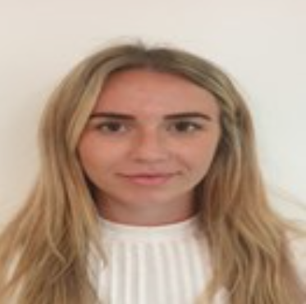
Welcome
Introduction
My name is Abbie. I work in the Human Resources department at Oakray, what do you think this role involves?
My Journey…

Slide 3
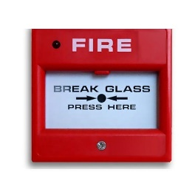
Who Are We?
Founded in 1979, Oakray has been providing buildings support to local authorities, social landlords, NHS trusts and private sector clients for over 40 years. We deliver successful mechanical, electrical and security solutions to our commercial and domestic clients.
Heating
Electrical
Gas
Fire Alarm
Security
Renewables

Slide 4
Work with Network Homes
Oakray provide mechanical solutions including breakdowns and repairs, electrical solutions including PAT testing, access control including CCTV and domestic including boiler installations. These are all both commercial and domestic works.

Slide 5
Opportunities and Pathways
Accounting
Electricians
Fire Alarm Engineers
Human Resources
Heating Engineers
Health & Safety
Security Engineers
Administration

Slide 6
Apprenticeships and Work Experience

Slide 7
Apprenticeship Courses Below is a list of some of the Apprenticeship courses that are available to us
Electrical Technical L3
Accountancy ATT L2, 3 & 4
Business Administration L2 & 3
Gas Engineering L2 & 3
Customer Services L2

Slide 8
Progression
Where do you see yourself in 10 years time?
It all starts with Work Experience!
Work Experience
2 Weeks
Pre-Apprenticeship
6 Weeks
Apprenticeship
£5.50 per hour
Engineer
£12 - £19 per hour
Supervisors
£30,000 - £40,000 per year
Managers
£40,000 - £60,000 per year
Senior Managers
£60,000 - £80,000 per year
Directors
£100,000 + per year

Slide 9
Success Stories

Slide 10
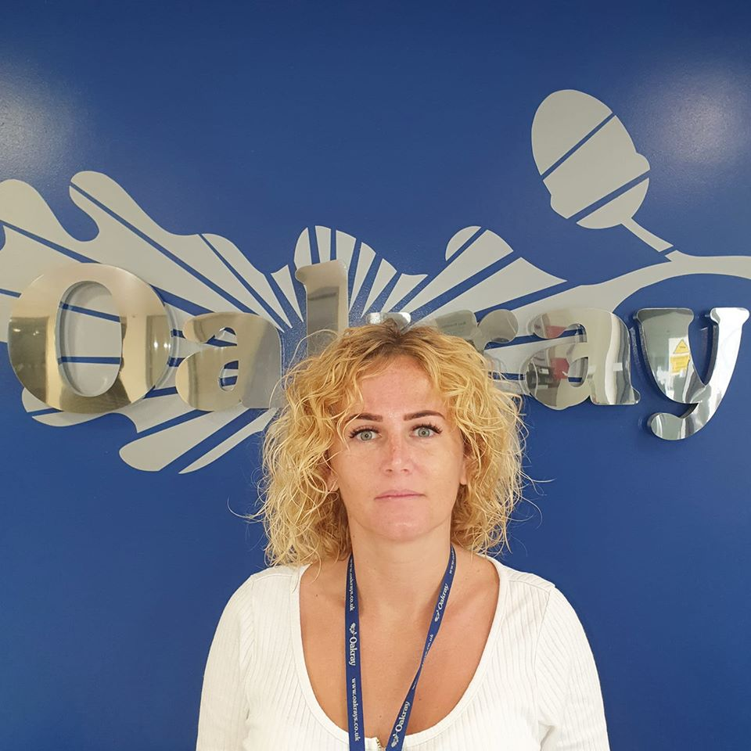
Emma
Meet Emma! Emma started her journey at Oakray in June 2019 by completing a 4 week, office based pre-apprenticeship within our HR department. Emma decided that it was time for a career change after working as a Chef for many years - our pre-apprenticeship scheme was the perfect opportunity for Emma to ensure that this was right career move for her. Emma showed commitment and dedication & she worked extremely hard during her pre-apprenticeship. As a result of this, we offered her a full-time position as Business & Administration Apprentice. Emma has now been offered a permanent position as HR Administrator with Oakray and is still a vital part of the HR department.
Emma says:
When I first joined Oakray, I was very nervous and apprehensive as it was my first time working in an office environment. I completed a 4-week pre-apprenticeship with them and at the end of it I was asked if I would like to stay on.
From day 1 everyone has been very friendly and helpful and I have quickly felt like part of the Oakray family. I love working for Oakray and I’m glad that they saw potential in me. Each day, I feel more and more confident in my role and this is simply down to the support I receive from the company and from my team members in HR.

Slide 11
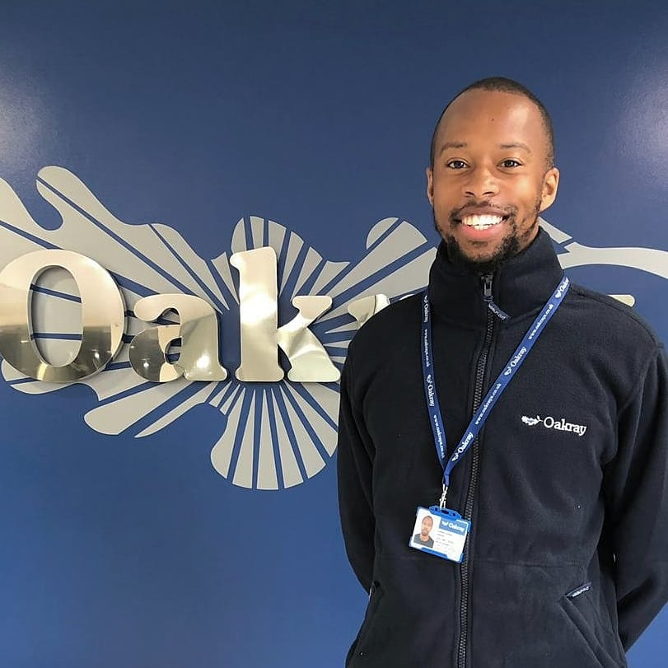
Karimm
Meet Karimm!
We met Karimm at an International Women’s Day event which was organised by one of our client’s back in March 2019. Karimm showed an interest in our pre-apprenticeship scheme as he wanted to obtain work place experience to compliment his Gas NVQ that he was working towards at the time.
Shortly after, we arranged for Karimm to come in for an interview at head office with HR and the Gas Team’s Senior Contract Manager – it’s safe to say that it was a success!
Karimm then started his journey at Oakray by completing a 10-week Pre-apprenticeship programme within our Domestic Gas and Heating department.
He had a great attitude; the Supervisor and engineers that he was working with were really impressed by his attitude, knowledge and determination to succeed.
Following his success on our programme, Karimm was then offered a full-time, permanent position. He is now working as an Improver on the Network London Contract, where he will continue to learn & train within the industry.
We would like to say a big Congratulations to Karimm. We wish him a long and successful career here at Oakray!

Slide 12
Nathan
Meet Nathan!
Nathan was seeking full time employment and the opportunity to become an apprentice. He interviewed with our contract manager and show great potential and enthusiasm. Nathan has now been with Oakray for 3 months and is currently enrolled onto a L3 gas engineering course.

Slide 13
Monir
Meet Monir!
Monir heard about the apprenticeship with Oakray through Westminster council. He received a leaflet explaining what apprenticeships are, how they work and explained all benefits from doing an apprenticeship vs just doing a the electrical installation course alone with no training. Westminster has many contracts and on enquiry they let Monir know that Oakray was looking for apprentices. Once Monir had the interview he was very excited to work with Oakray.
Monir has now completed his apprenticeship and was offered an electrical improver position at Oakray on 21 January 2022 . Monir says that he enjoys working at Oakray two days are the same, you've always got a variety of interesting jobs to complete and figure out.

Slide 14
Interviews...
You should be proud of yourself for getting invited in for an interview – your CV, skills and experience must have stood out to the recruiter!
The interview is your opportunity to demonstrate how and why you would be a good fit for their role. It is a chance for you to discuss your skills and experience in greater detail and most importantly let them know what you think you could bring to their organisation.
Top Tips
Be Yourself
Look at the company’s website
Review the job description
Plan your Travel
If a question throws you off track, don’t be afraid to ask the interviewer to repeat / explain the question
Body language is key – keep eye contact with the interviewer and remember, a positive posture may help you feel more confident.
First impressions count – make sure you look smart, professional and appropriate for your interview. Your handshake is also important, so look the interviewer in the eye, shake firmly and smile!
Go to your interview prepared with questions – This will show that you are interested but also will help you to visualise what it would be like to work there.
E.g. Are there any training opportunities within the company?
What is the best thing about working here?
When can I expect to hear from you with a decision?

Slide 15
Typical Interview Questions and What we Look for
What interested you about this position?
What skills do you have that would be beneficial
to the role?
What do you know about the company?
Tell me about a time when you have had to work under pressure.
Please give me an example of when you have worked in a team.

Slide 16
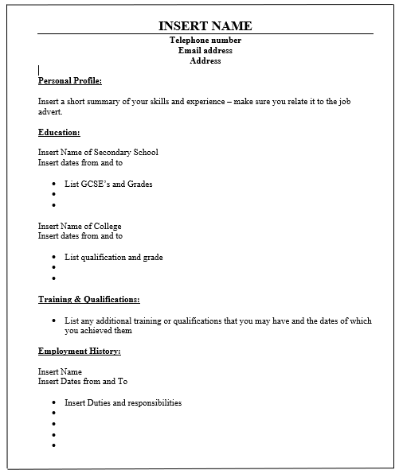
Sample CV...

Slide 17
CV Writing

Slide 18
What it Takes…
Willingness to Learn
Commitment
Passion
Motivation
Determination
Ambition
Teamwork
Hard Work

Slide 19
Any Questions

Slide 20
Thank you for listening!

