Slide 1
AN INSIGHT TALK WITH ARJ CONSTRUCTION

Slide 2
INTRODUCTION
We have been around for more than 30 years
We are based in Stevenage but work mainly in London
We construct new buildings and refurbish old ones
Most of our projects are apartment blocks, but we have also worked on offices, education, retail and hospital projects
Our past and current clients include: Booking.com, Metro Bank, Network Homes, Southern Housing Group, Brunel University, and Thomas’s School

Slide 3
WHAT WE’LL COVER TODAY
Mini quiz – What do you know about the UK construction industry?
Our work with Network Homes
An industry overview
Opportunities and pathways into construction
Our success stories
Applying for jobs and preparing for interviews
Any questions?

Slide 4
MINI QUIZ
What is the annual turnover of the UK construction industry?
£117 billion
£250 billion
£50 billion

Slide 5
MINI QUIZ
How many UK based companies are linked to the construction sector?
100,000
200,000
300,000

Slide 6
MINI QUIZ
How many people are employed in the UK construction industry?
1 million
3 million
4 million

Slide 7
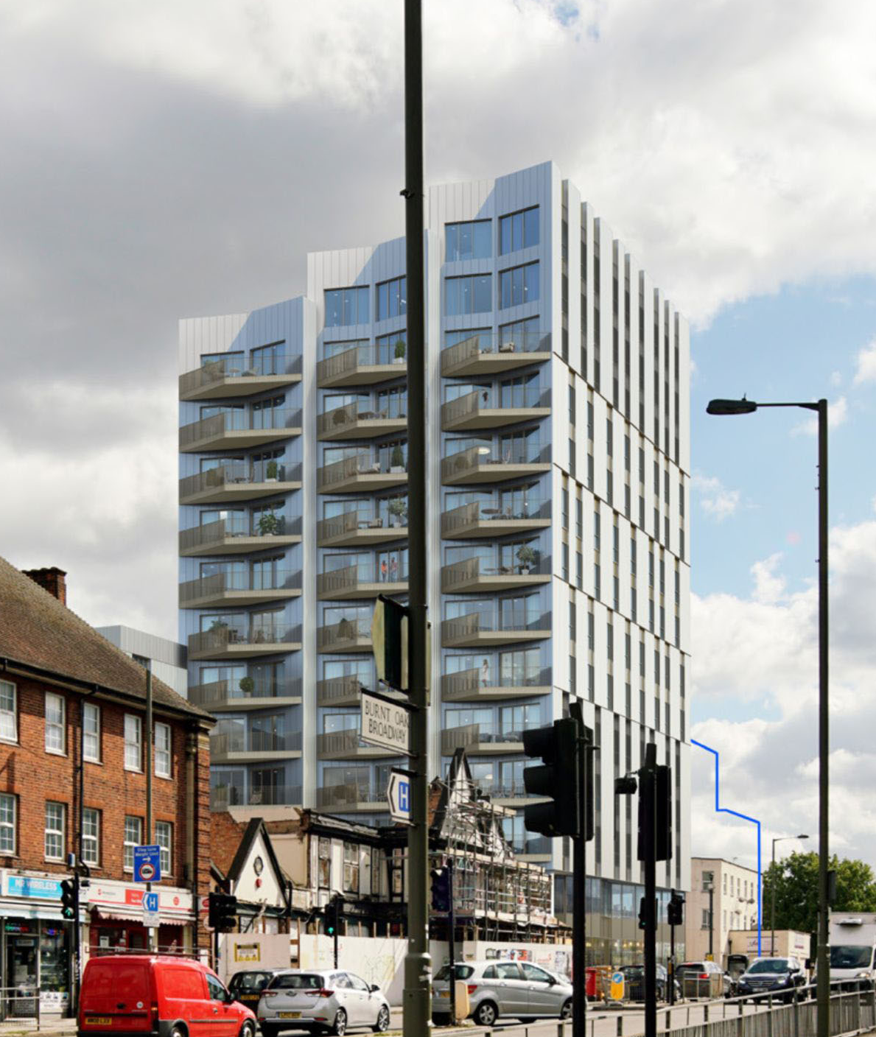
OUR WORK WITH NETWORK HOMES
We are building 100 apartments, office space, and an underground car park at 98-102 Burnt Oak Broadway
We are using concrete reinforced with steel for the main structure
The building will be 13 storeys high with a basement
The project value is over £21million
There’ll be up to 80 people working on site, plus head office and supply chain support

Slide 8
AN INDUSTRY OVERVIEW
The construction sector is one of the largest in the UK economy, employing 3.1 million people. That’s nearly 10% of the whole workforce!
There is a large skills shortage in the industry, meaning lots of opportunities for jobs and apprenticeships
We are a main contractor, like most construction companies
Main contractors are like event planners. We bring lots of specialists together, like architects, structural engineers, ground workers, concrete frame subcontractors, bricklayers and kitchen installers
Main contractors plan how a building will be built (logistics and construction method) and then manage all the specialists to build it correctly

Slide 9
OPPORTUNITIES AND PATHWAYS INTO CONSTRUCTION
There is a wide variety of jobs in the industry
Jobs can be academic/white collar or vocational/blue collar
Main contractor opportunities include: site and project managers, technical roles, like design management, roles involving money, like quantity surveying and finance, and support roles like marketing, bid writing, HR, IT, and buying
Trade opportunities (blue collar) include: electricians, plumbers, bricklayers, carpenters and many more
71% of apprentices come via SMEs (trades/subcontractors)

Slide 10
OPPORTUNITIES AND PATHWAYS INTO CONSTRUCTION
Construction involves a lot of social value, which means we work with and support charities, schools, colleges, and businesses in the communities close to our sites
We hire apprentices through an Apprenticeship Training Agency like Joe Brennan Training
The minimum entry level requirement for an apprenticeship is Level 4 in English and Maths
It can take 1-7 years to qualify in a particular field e.g. architect 7 years full time vs carpenter 2 years full time. Study times will vary for full time vs part time courses

Slide 11
OUR SUCCESS STORIES
Three of our quantity surveyors completed their degrees via Higher Apprenticeship schemes whilst being employed and achieved First Class Honours. They are already managing some of their own projects
We have seven trainee surveyors working for us whilst completing their degrees
We currently have two site management trainees working for us
Brenda walked onto one of our sites, asked for a job, impressed our site management team and is now an employee
We will have five trade apprentices on our Burnt Oak project via Joe Brennan Training, plus others on other sites
Notes:
Brenda walked onto one of our sites, asked for a job, impressed our site management team and is now an employee

Slide 12
APPLYING FOR JOBS AND PREPARING FOR INTERVIEWS
Attitude
Be proactive - ‘be more Brenda’
Show enthusiasm and commitment
Adopt good time management
Remember the employment market is competitive
Notes:
Brenda walked onto one of our sites, asked for a job, impressed our site management team and is now an employee

Slide 13
APPLYING FOR JOBS AND PREPARING FOR INTERVIEWS
CV Tips
Your CV should be up to date and concise
Check spelling, grammar and dates of education/work experience carefully
Prepare a covering email to send to an employer/agency explaining why you should be considered and why you want to work in construction/for that business
Include an ‘About me’ section – avoid cliches and hobbies. Use this space to describe your attributes e.g. strong leader and very organised. Include examples
Make sure your CV is presentable (especially for creative roles) and include contact details. Templates are available online to help
Ask someone to review your CV. A second pair of eyes is always good

Slide 14
APPLYING FOR JOBS AND PREPARING FOR INTERVIEWS
Interview Tips
Research, research, research!
Be presentable – smart appearance and remember to smile and hold eye contact
Be on time, every time
Shake hands
Be confident – they chose to interview you after all!
Remember to take note of the interviewer’s name

Slide 15
APPLYING FOR JOBS AND PREPARING FOR INTERVIEWS
Interview Tips Continued…
Familiarise yourself with your own CV
Be familiar with the job description and ready to explain why your skills match what the company is looking for
Review typical interview questions and be ready to talk about past experiences (work and life based) that demonstrate the skills you stated on your application
Think of 2-3 questions you might want to ask during/at the end of the interview

Slide 16
APPLYING FOR JOBS AND PREPARING FOR INTERVIEWS
Interview Tips Continued…
If an interview is online:
Make sure your volume and camera are turned on
Consider location – where you conduct the interview from is important
Blur your background
Minimise background noise
Be smartly presented

Slide 17
Thank you for your attention
Any Questions?
Feel free to contact Michael Wright or Sam Carroll via email: recruitment@arj.co.uk
or to visit our website www.arj.co.uk

